Slide 1

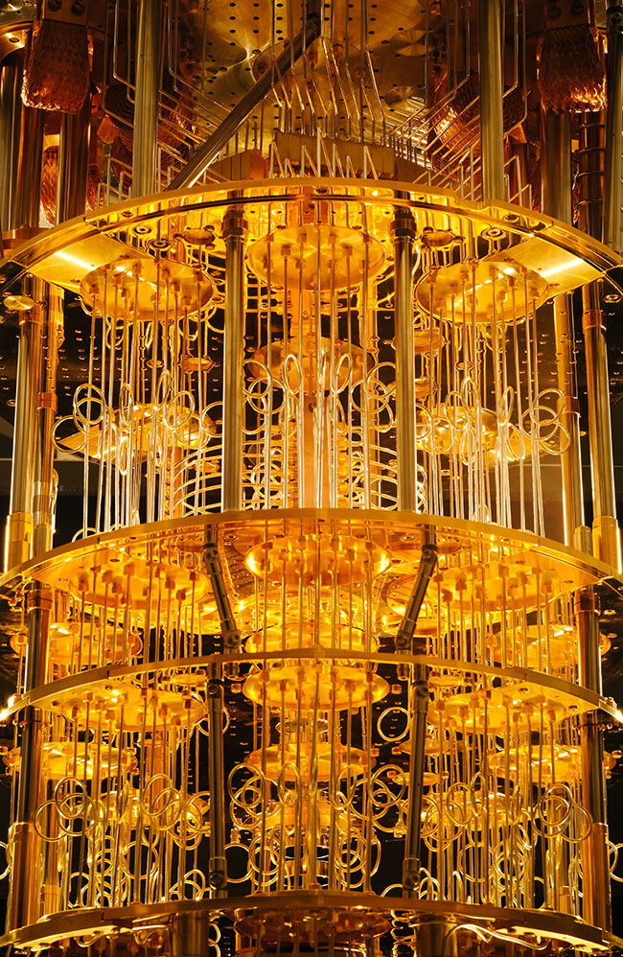
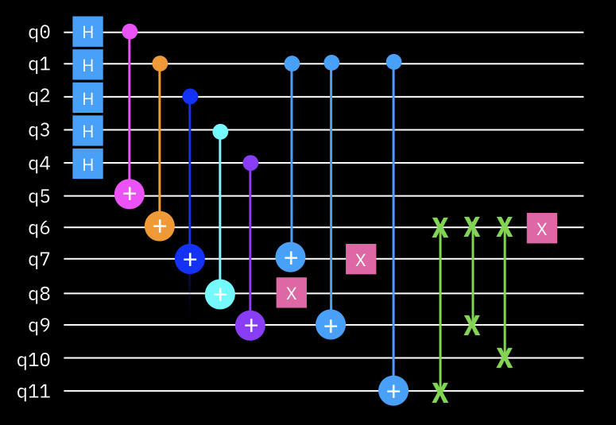
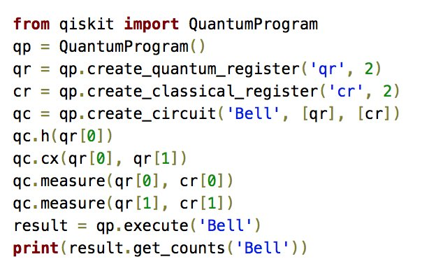
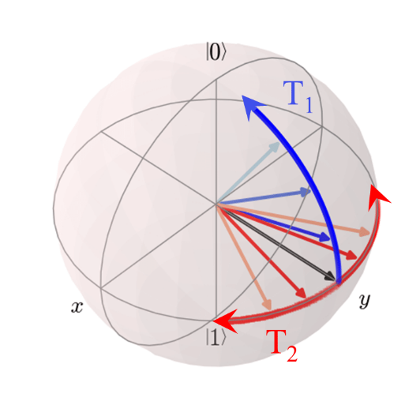

Foundations of
Quantum Computing
(QIS 301)
Dave Biersach
Brookhaven National Laboratory
dbiersach@bnl.gov
Session 07
Numerical Integration

Slide 2
Session Goals
Derive Simpson's Rule for numeric integration
Calculate the area of a unit circle using Simpson's Rule
Use the Python package scipy for numeric integration
Find the area under the Standard Normal curve
Relate area to cumulative probability function (CDF)
Evaluate the efficiency of an adaptive quadrature approach

Slide 3
Why do we need integrals?
How to calculate the total change in a variable X
When variable X depends on the changes in variable Y…
… and variable Y depends on the changes in variable Z…
… and variable Z is constantly changing…
Think about an accelerating car and the total distance it will travel in each number of seconds
The total distance depends on the velocity of the car…
… the velocity of the car depends on the acceleration
… and the acceleration is constantly changing

Slide 4
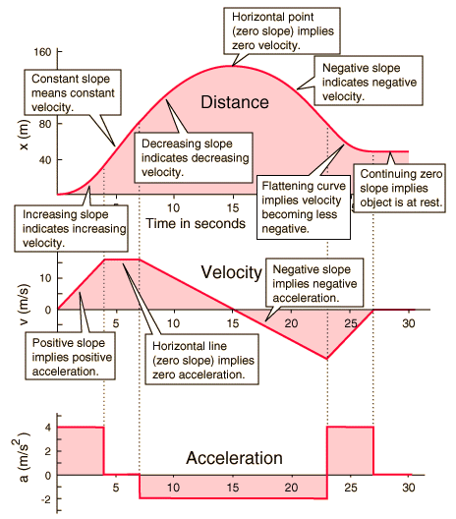
Why do we need integrals?

Slide 5
Why do we need integrals?

Slide 6
Why do we need integrals?
s
s
Differentiate
v
v
Integrate
a
a

Slide 7
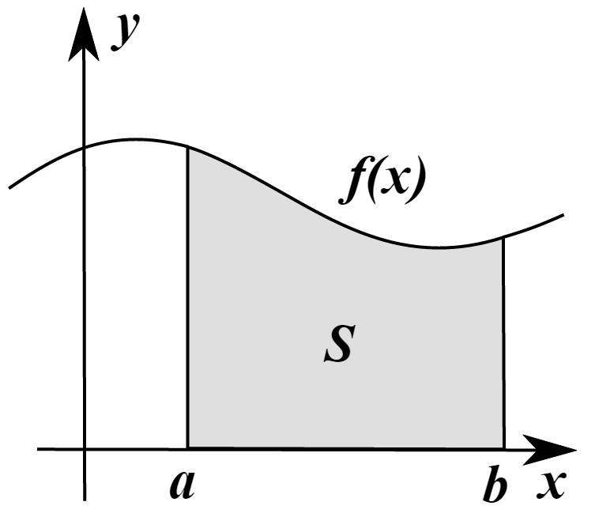
Why do we need integrals?
The integral of a function can be defined as the area under the curve f(x) within the region [a,b]
Sometimes there are methods to determine exactly the value of the integral of f(x) which we would write $F\left(x\right)=\int_{a}^{b}{f(x)}$
However, sometimes it is not possible to find an analytic expression for $F\left(x\right)$– so we use numerical integration

Slide 8
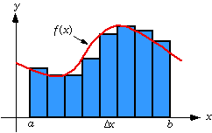
Riemann Sums
One way we can integrate f(x) is to divide the area under the curve into strips (intervals) and sum the area of each strip
This estimate may not be totally accurate because we might have gaps between the true value of f(x) and the top of a strip

Slide 9
Riemann Sums
The width of each strip is $Δx= \frac{(b−a)}{\# of intervals}$
We can minimize the gaps by increasing the number of intervals, which makes the $Δx$ smaller
There are different strategies for determine the shape and height of each strip
Left-hand Rule, Right-hand Rule, Midpoint Rule
Fit Trapezoids
Fit Parabolas (Simpson’s Rule)
Depending upon the shape of $f(x)$, one method might be more accurate than the others

Slide 10
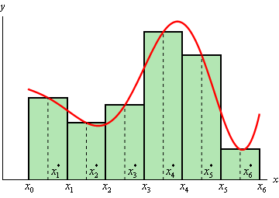
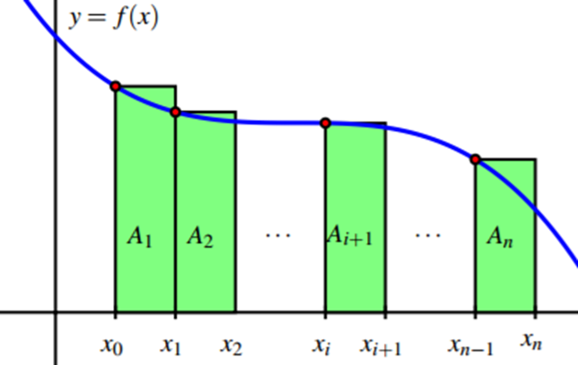
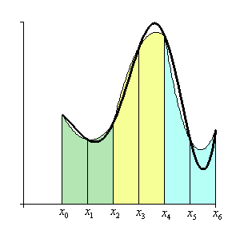
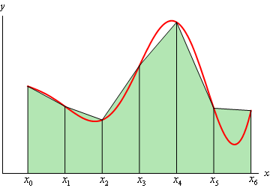
Riemann Sums
Left-Hand
Midpoint
Trapezoids
Parabolas
(Simpson’s Rule)

Slide 11
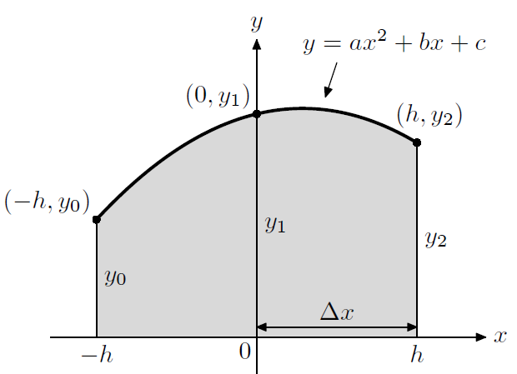
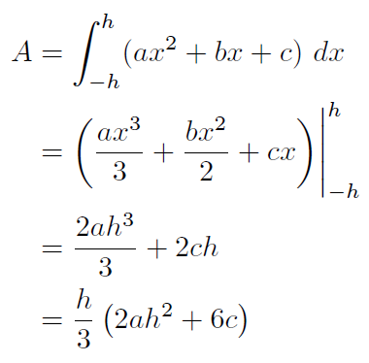

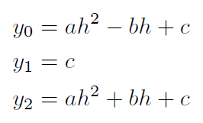
Deriving Simpson’s Rule

Slide 12
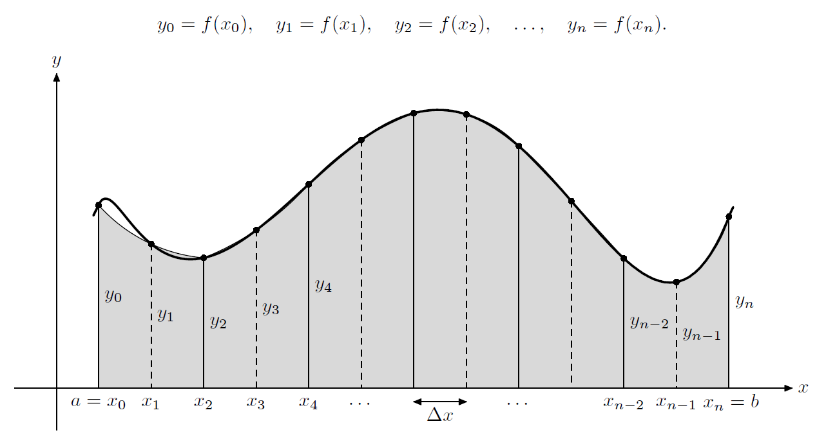

Deriving Simpson's Rule
Interval #1
$$1y_{2}+…)$$

Slide 13
Deriving Simpson's Rule
Interval #2
$$2y_{2}+4y_{3}+1y_{4}…)$$

Slide 14
Deriving Simpson's Rule
Interval #3
$$2y_{2}+4y_{3}+2y_{4}+4y_{5}+1y_{6}+…)$$

Slide 15
Deriving Simpson's Rule
Interval
# n

Slide 16
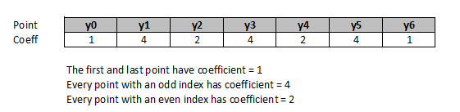
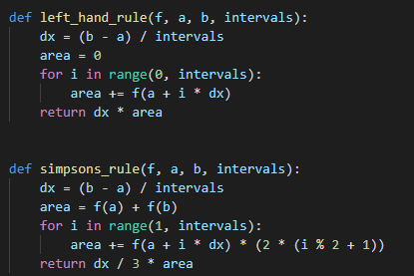
Deriving Simpson's Rule
$$a$$
$$b$$

Slide 17
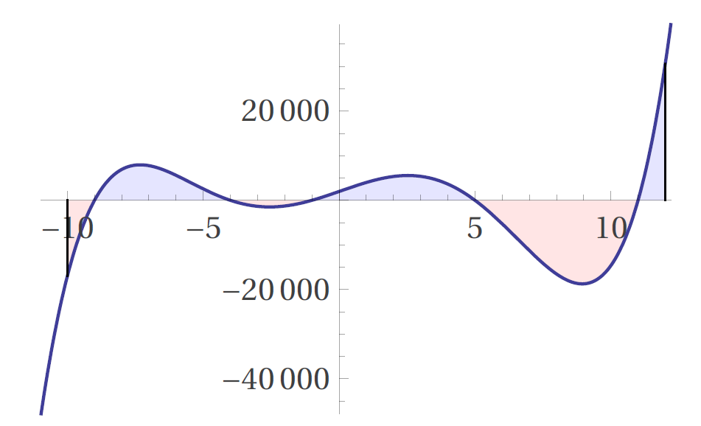
Analytic Integration
$$F\left(x\right)=\int{x^{5}−{2x}^{4}−120x^{3}+22x^{2}+2119x+1980ⅆx}$$
$$(x+9)(x+4)(x+1)(x−5)(x−11)$$

Slide 18
Analytic Integration
$$=\int_{−10}^{12}{x^{5}−{2x}^{4}−120x^{3}+22x^{2}+2119x+1980ⅆx}$$
$$=\left(\frac{x^{6}}{6}−\frac{2x^{5}}{5}−30x^{4}+\frac{22x^{3}}{3}+\frac{2119x^{2}}{2}+1980x\right)\left|\begin{matrix}12 \\ \\ −10\end{matrix}\right.$$
$$\left[\frac{−174744}{5}−\frac{−43550}{3}\right]=\frac{−306482}{15}=−20432.13333$$

Slide 19
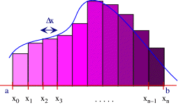
Open simpsons_rule.py
Compare the percent error in the estimate of the integral provided by the left-hand rule vs. Simpson’s rule

Slide 20
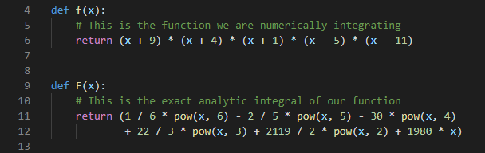
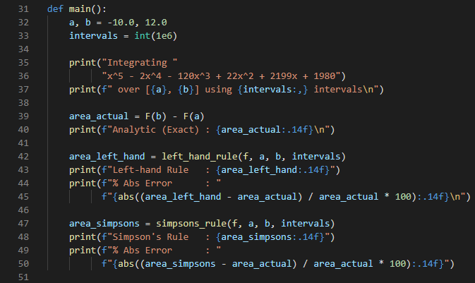
View simpsons_rule.py
In Python we often pass a "function" name as a parameter so a separate function can then call it

Slide 21
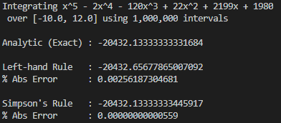
Run simpsons_rule.py
Sometimes dealing with a tiny bit more complexity is more than worth it!

Slide 22
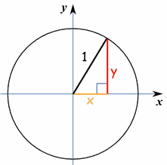
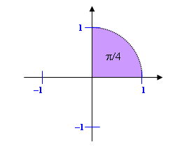
Area of a Unit Circle
Update the code so the $f\left(x\right)$ function represents the correct integrand for the area of a unit circle
$$F\left(x\right)=4\int_{0}^{1}{\sqrt{1−x^{2}}ⅆx}$$

Slide 23
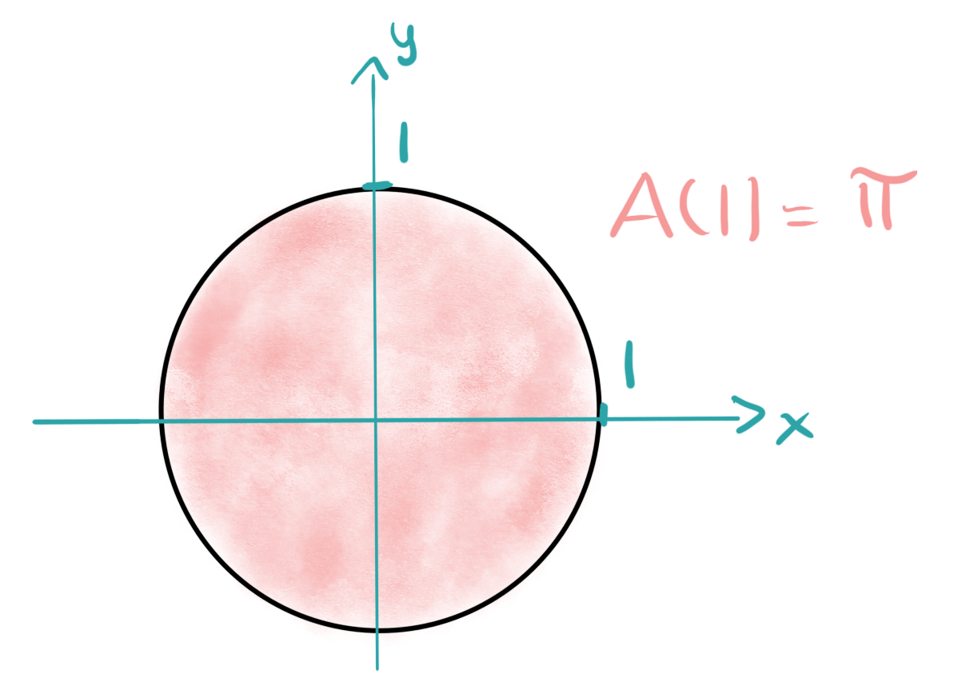
$$F\left(x\right)=4\int{\sqrt{1−x^{2}}ⅆx}$$
$$F\left(x\right)=2\left(x\sqrt{1−x^{2}}+\sin^{−1}\left(x\right)\right)+C$$
$$4\int_{0}^{1}{\sqrt{1−x^{2}}ⅆx}$$
$$F\left(0\right)=2\left(0\sqrt{1−0^{2}}+\sin^{−1}\left(0\right)\right)=0$$
$$F\left(1\right)=2\left(1\sqrt{1−1^{2}}+\sin^{−1}\left(1\right)\right)$$
$$F\left(1\right)=2\left(\frac{π}{2}\right)=π$$

Slide 24
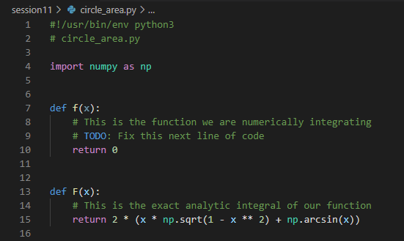

Edit circle_area.py
①

Slide 25
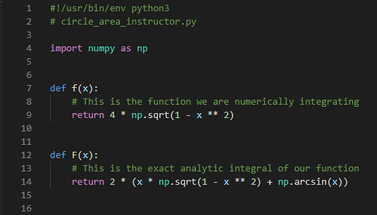
Run circle_area.py
①

Slide 26
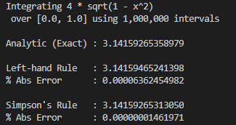
Run circle_area.py
Must we keep reimplementing Simpson's Rule every time we need to calculate an integral?

Slide 27

https://www.scipy.org

Slide 28
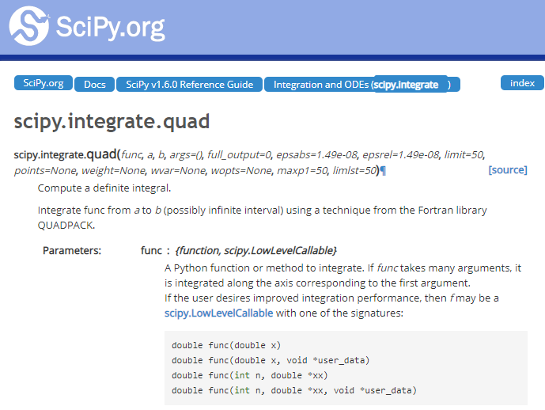
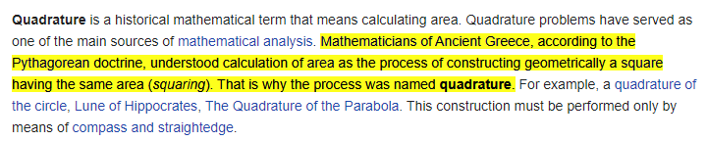
https://www.scipy.org
??

Slide 29
Completing What Square?
$$ax^{2}+bx+c=0$$
$$ax^{2}+bx=−c$$
$$\frac{1}{a}\left(ax^{2}+bx\right)=\frac{1}{a}\left(−c\right)$$
$$x^{2}+\frac{b}{a}x=\frac{−c}{a}$$

Slide 30
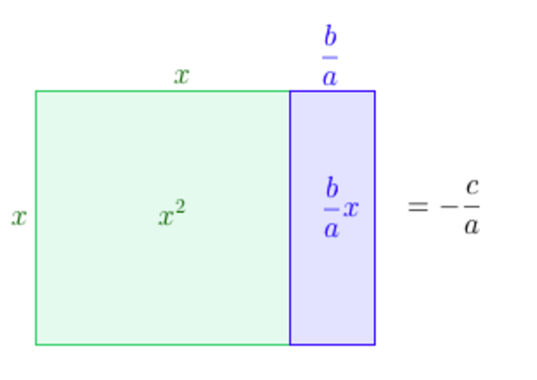
Completing What Square?
$$x^{2}+\frac{b}{a}x=\frac{−c}{a}$$

Slide 31
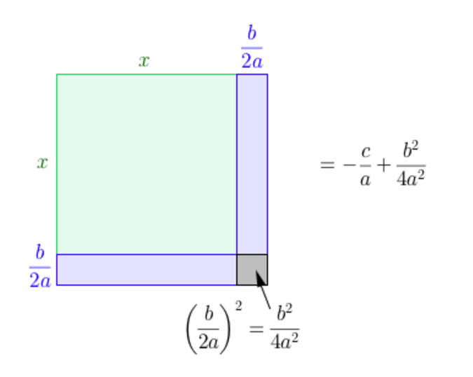
Completing What Square?
That square!

Slide 32
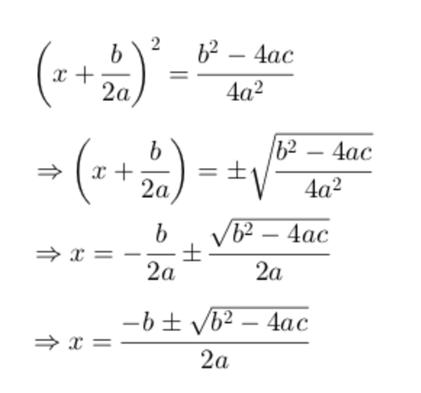
Completing What Square?

Slide 33
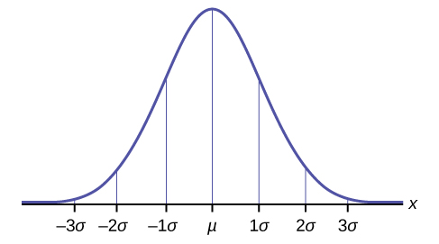
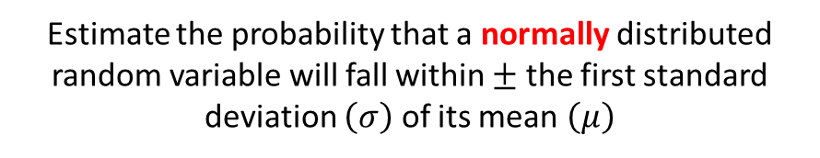
Cumulative Distribution Function
Estimate the probability that a normally distributed random variable will fall within $±$ the first standard deviation $\left(σ\right)$ of its mean $\left(μ\right)$
The integral (the area under the curve) of a probability distribution function (PDF) indicates the probability an observation will fall within that interval
Assume we have a standard normal distribution for this problem

Slide 34
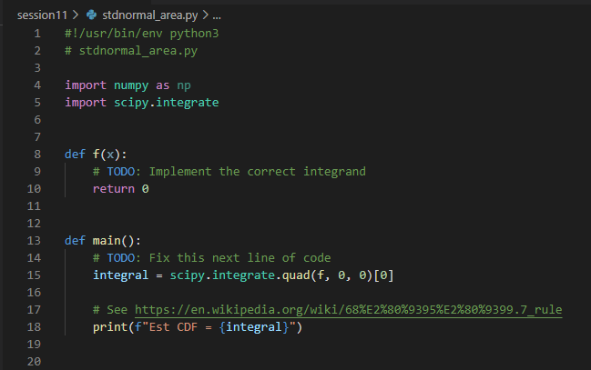
Edit stdnormal_area.py
Using the scipy quadrature function, estimate the area under the standard normal curve
from $−1$ to $1$
$$f\left(x\right)=\frac{1}{σ\sqrt{2π}}e^{\frac{−{\left(x−μ\right)}^{2}}{2σ^{2}}}$$
①
②
Is this area the same as the probability of a normally distributed random variable falling within the first standard deviation away from the mean?

Slide 35
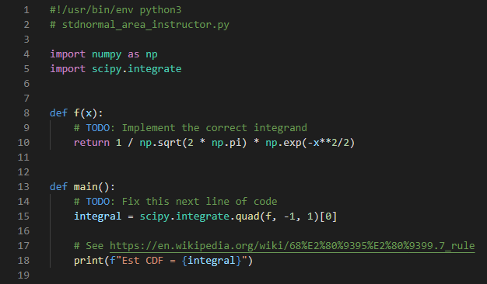
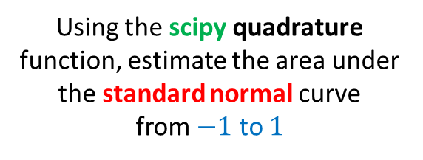
Run stdnormal_area.py
Using the scipy quadrature function, estimate the area under the standard normal curve
from $−1$ to $1$
$$f\left(x\right)=\frac{1}{σ\sqrt{2π}}e^{\frac{−{\left(x−μ\right)}^{2}}{2σ^{2}}}$$
①
Is this area the same as the probability of a normally distributed random variable falling within the first standard deviation away from the mean?
②

Slide 36
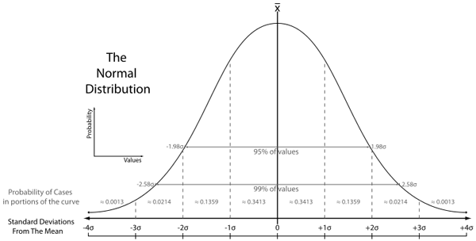
Cumulative Distribution Function
Estimate the probability that a normally distributed random variable will fall within $±$ the first standard deviation $\left(σ\right)$ of its mean $\left(μ\right)$

Slide 37
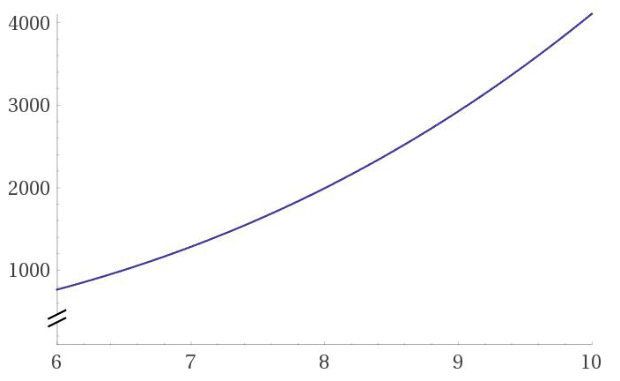
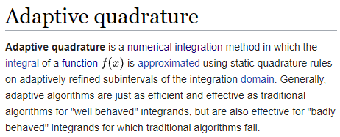
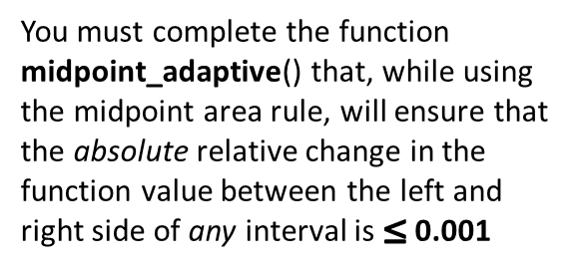

Adaptive Quadrature
Calculate the following integral using the midpoint rule:
$$f\left(x+Δx\right)$$
This large $∆x$ makes
$$\left|\frac{f\left(x+Δx\right)−f\left(x\right)}{f\left(x\right)}\right|$$
exceed the limit
$$\int_{0}^{10}{5x^{3}−9x^{2}+11}$$
$$f\left(x\right)$$
$$Δx$$
You must complete the function midpoint_adaptive() that, while using the midpoint area rule, will ensure that the absolute relative change in the function value between the left and right side of any interval is $≤$ 0.001
Therefore, we need to reduce $∆x$ to keep the absolute relative change in the function value across the interval $≤$ 0.001
The function midpoint_fixed() is set to use 1 million fixed width intervals. How does the midpoint_adaptive() quadrature compare in terms of relative % error and overall execution time?

Slide 38
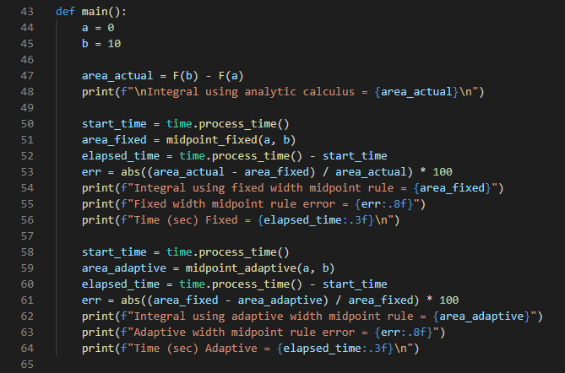
Open adaptive_quadrature.py
①
$$\int_{0}^{10}{5x^{3}−9x^{2}+11}$$
②
③
④
③
④

Slide 39
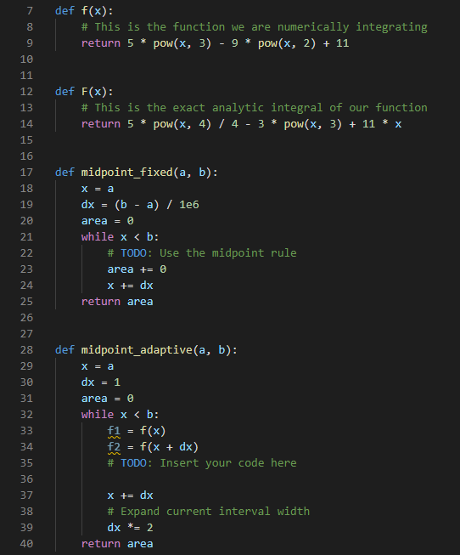
View adaptive_quadrature.py
$$f\left(x\right)=\int{5x^{3}−9x^{2}+11}$$
①
$$F\left(x\right)=\frac{5x^{4}}{4}−3x^{3}+11x$$
②
①
②
$$\int_{0}^{10}{5x^{3}−9x^{2}+11}=9610$$

Slide 40
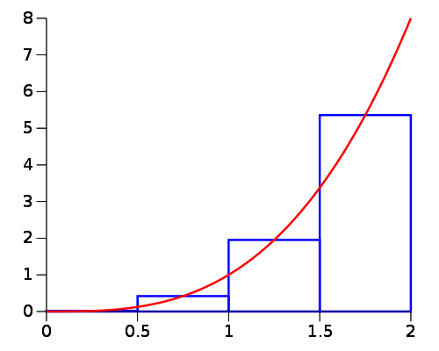
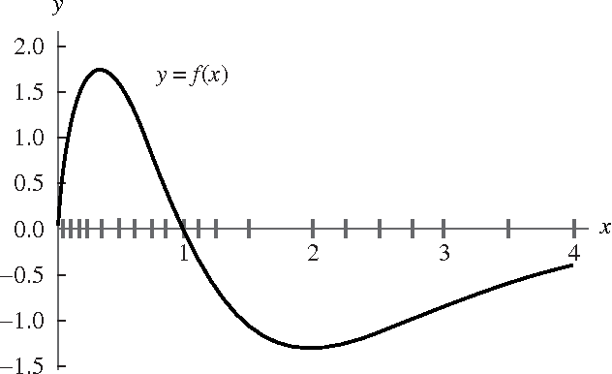
Edit adaptive_quadrature.py
$$Δx$$
①
$${Δx}_{fixed}$$
②
$${Δx}_{variable}$$

Slide 41
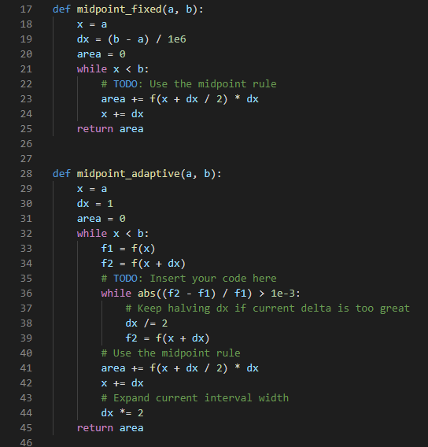
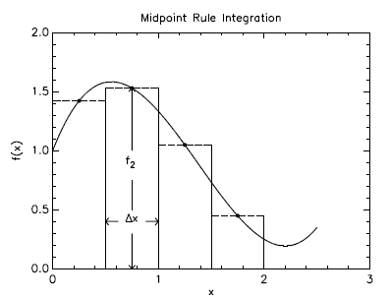
Edit adaptive_quadrature.py
①

Slide 42
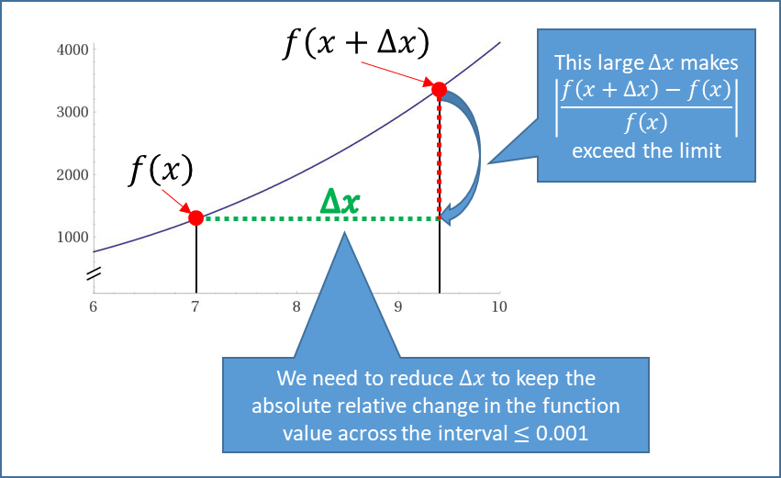
Edit adaptive_quadrature.py
②
③
④
⑤

Slide 43

Run adaptive_quadrature.py
Sometimes dealing with a tiny bit more complexity is more than worth it!

Slide 44
Now you know…
Simpson's Rule provides better estimates for most integrands
The Python package scipy has numerous built-in functions for numerical analysis
The integral of a PDF is its CDF and that will determine the probability a random variable will fall within a specified range
Methods like adaptive quadrature can often return results faster than methods using fixed width intervals
Stop just trying to memorize formulas – learn how to derive them from first principles
The ability to regurgitate on demand an esoteric equation doesn't mean you truly understand it nor does that prove you are super smart

